Slide 1
Bank CRM
Project
Presentation
by Yash Kumar

Slide 2
Bank CRM Overview
This capstone project delves into Bank Customer Relationship Management (CRM). CRM empowers banks to build stronger relationships through data analysis.
Our CRM system serves as a strategic tool for fostering stronger connections with our customers. Its centralized customer data, enabling personalized interactions, targeted marketing, and effective issue resolution.
Through segmentation and analytics, we identify customer needs, preferences, and behaviors, empowering us to tailor offerings and experiences. With a focus on retention and satisfaction, our CRM drives loyalty, revenue growth, and operational efficiency.
Let’s explore the transformative power of CRM in banking.

Slide 3

Problem Statement
You are an analytical CRM (Customer Relationship Management) specialist hired by a bank to extract meaningful insights from various customer-related datasets.
The bank aims to reduce customer churn, improve service delivery, and enhance customer satisfaction.
They have provided you with datasets including customer demographics, transaction details, customer exit information, and active customer profiles.

Slide 4
Process Cycle
Data Consolidation and Preprocessing
4
Data Storage and Manipulation
Transformation of data using Excel & PowerBI
Import processed Excel data into SQL & write Queries
1
3
Data Analysis and Visualization
Objectives and Documentation
SQL Queries output, and visuals & dashboarding in PowerBI
Determining Insights, Issues, Strategies of churn & documenting it
2

Slide 5

Let’s dive into data bank!
Bank’s data of Customer Relations is quite complex and vast.
My Excel sheet Bank_CRM & PowerBI sheet unveils data of customers, their behaviours & relationship with bank and trends discussed in this presentation.
Data is prepared, and ready to be deposited
So let’s just get into it!

Slide 6
Data Consolidation & Preprocessing
Fixed inconsistent values Corrected format in Excel of Joining Date (BOJ) in ‘YYYY-MM-DD’ format that SQL recognises
Checked missing/error values Checked the Errors & Null values through Quality Columns in the View Tab, using Transform Data in PowerBI
Generated new data and measures In PowerBI, Generated new calculated column named Spending in Customer Info table and Credit Score Group & Churn Risk Score (CRS) in Bank Churn table.
Formatted Table & Model view Created data in table view and checked for Model view for any cardinality if needed.

Slide 7
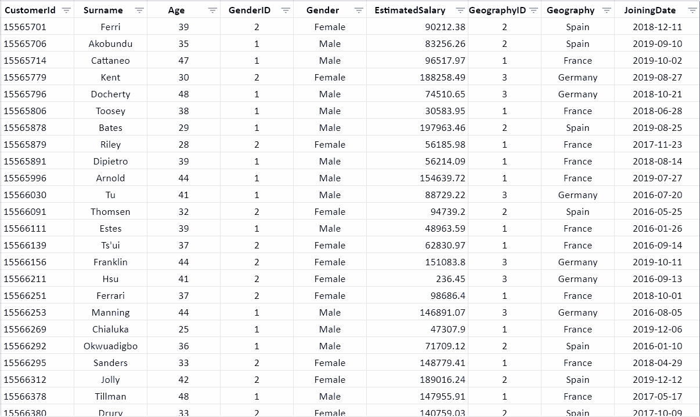
Customer Info (Excel)

Slide 8
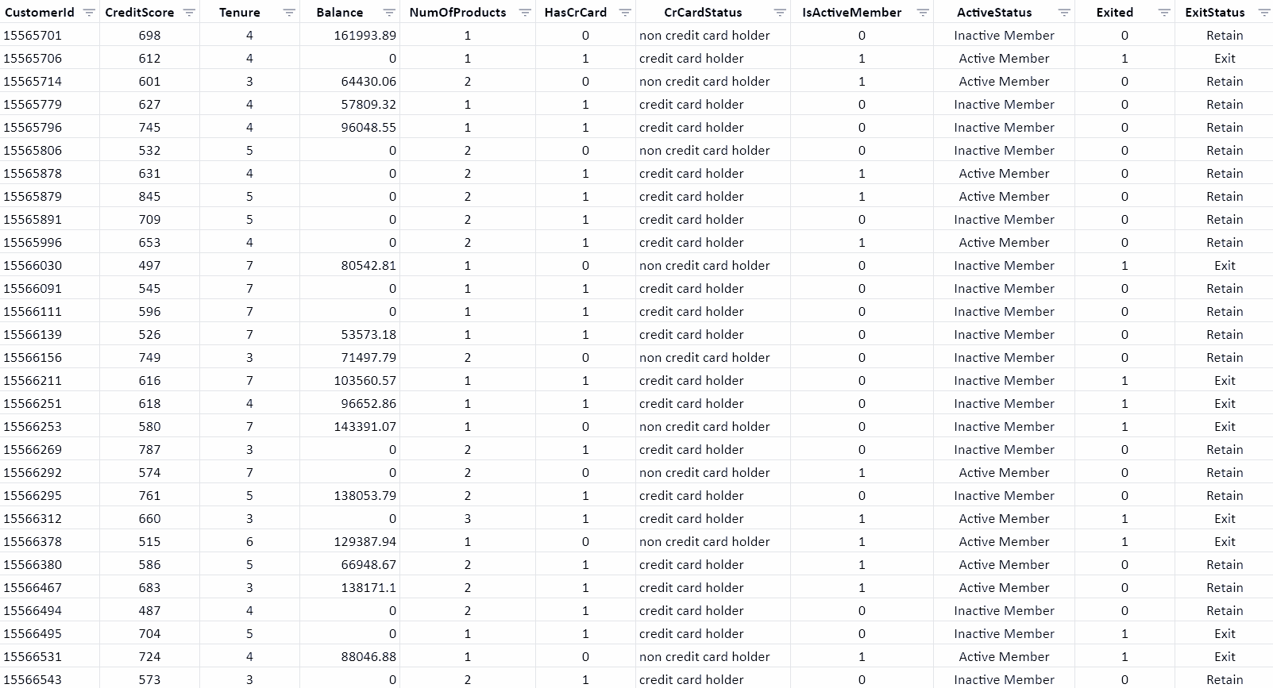
Bank Churn (Excel)

Slide 9
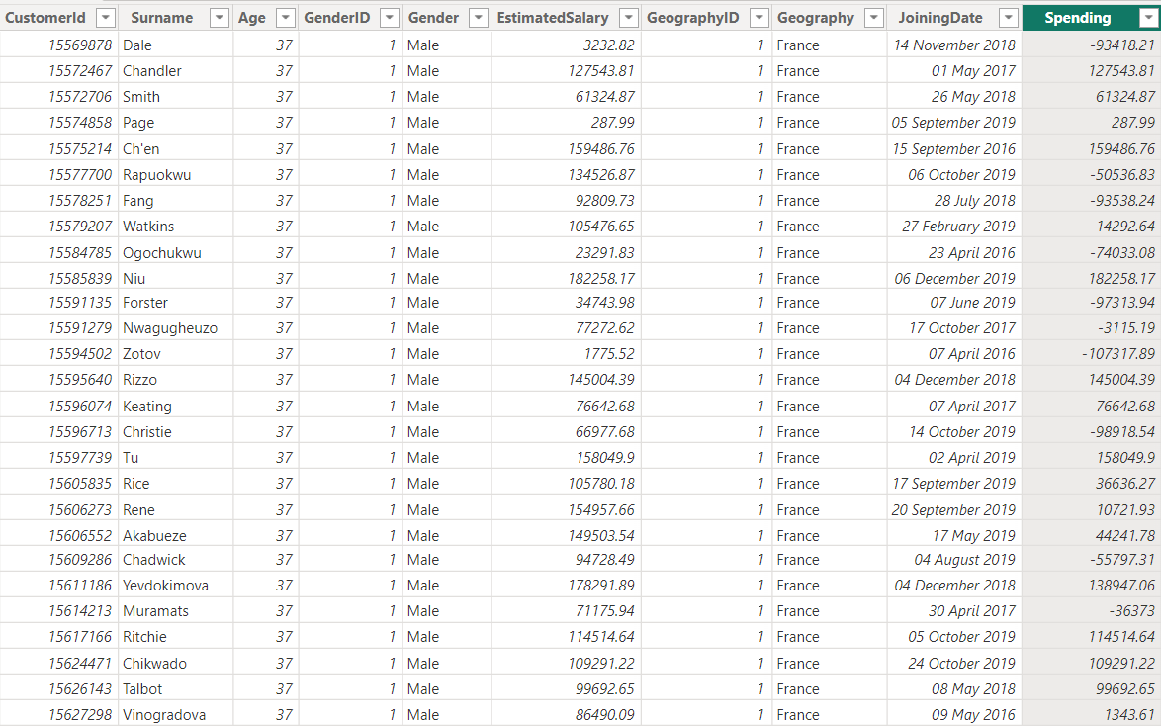
Customer Info (PowerBI)

Slide 10
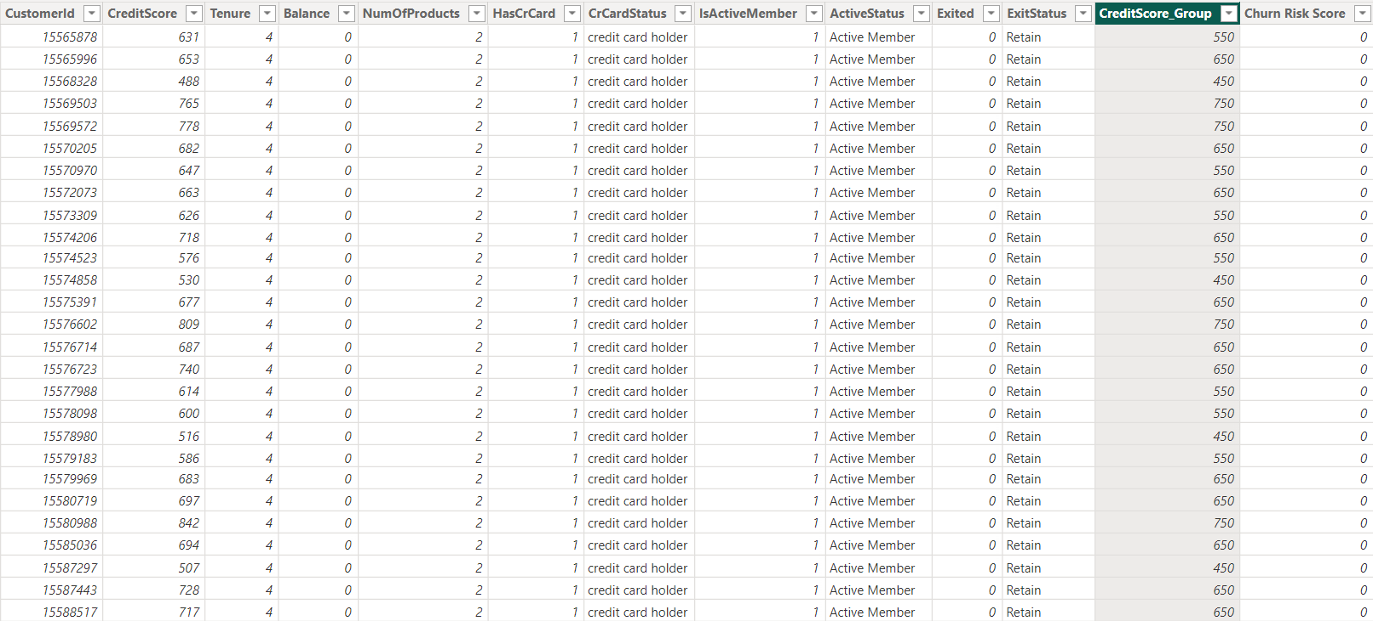
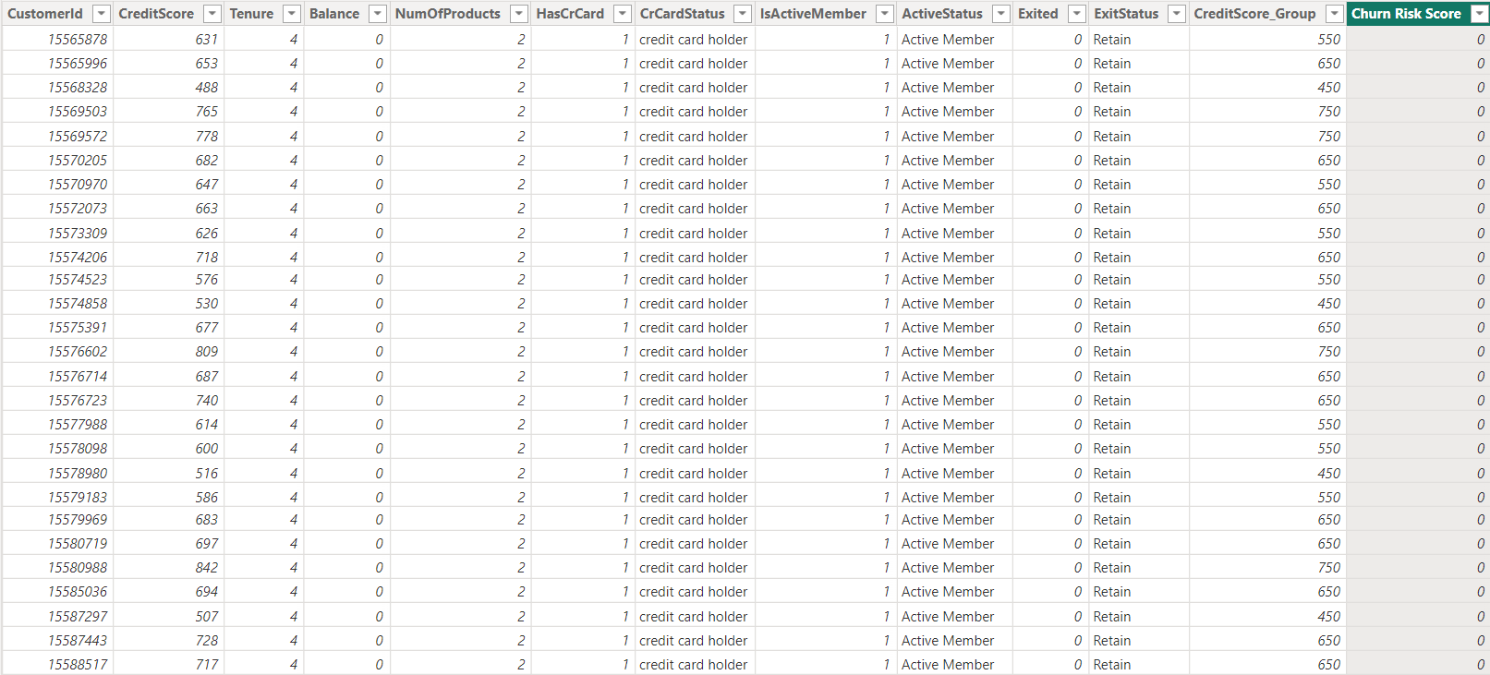
Bank Churn (PowerBI)

Slide 11
Data Storage & Manipulation
Imported Data into SQL Imported data from Excel into MySQL workbench and stored in database
Written Queries in Workbench Manipulated data by writing queries, extracting meaningful insights from it
SQL Concepts Used Basic & Advanced SQL concepts to solve objective questions

Slide 12
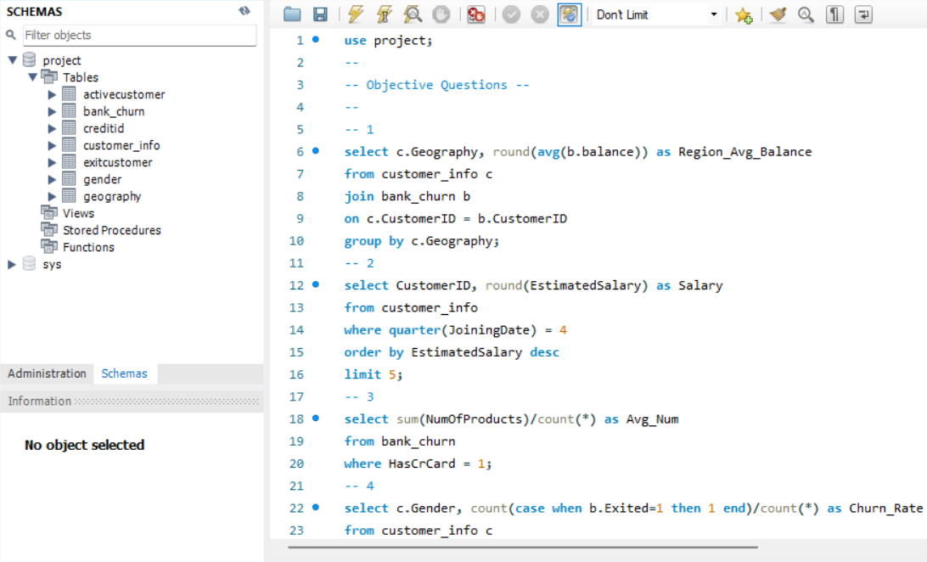
SQl Queries
MySQL Workbench

Slide 13
Data Analysis & Visualization
SQL Outputs Extracted meaningful insights from output of SQL queries (can be seen in Doc file)
PowerBI Visuals Created Dashboard and relevant charts & visuals in PowerBI, compliment to SQL outputs
Excel Pivot Created Pivot Table in Excel sheet for some data insights.

Slide 14
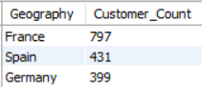
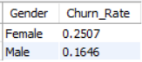
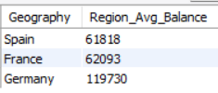
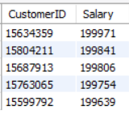
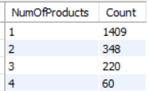
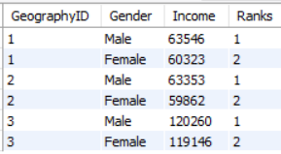
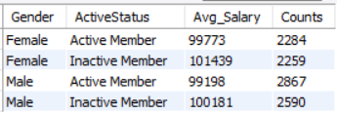
Query Outputs
All of the SQL outputs with problem statements and explanation can be accessed in document file.

Slide 15
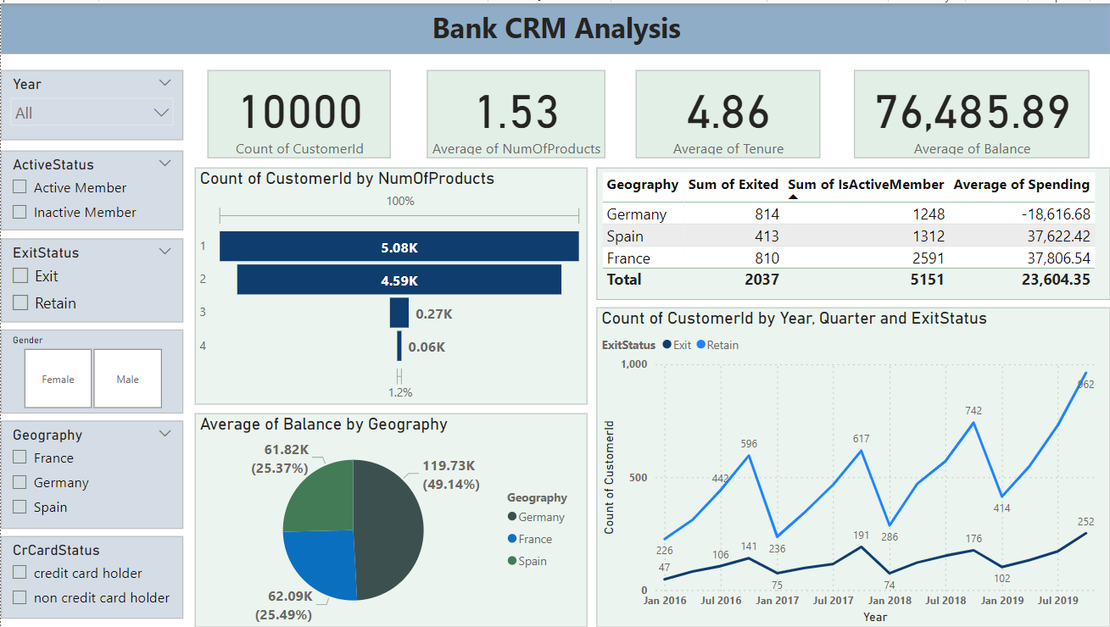

Slide 16
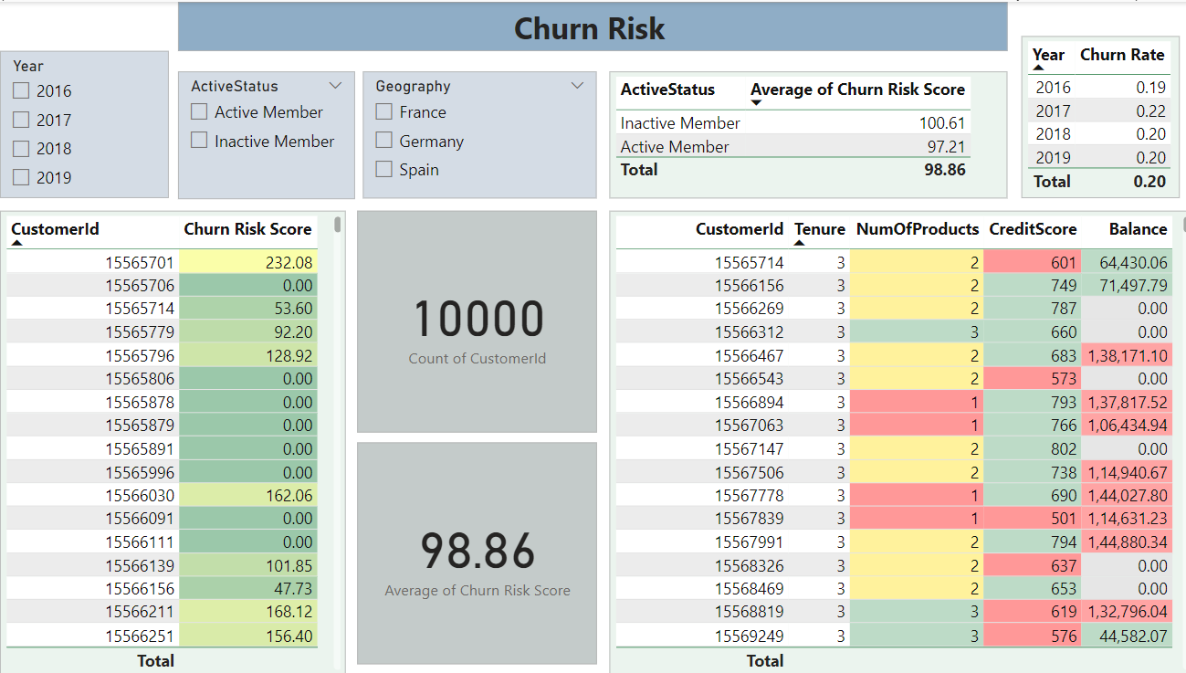

Slide 17

Statistical Insights
Total Customers: 10,000
Total Exited Customers: 2037
Total Active Customers: 5151
Average No. of Products (used by customers): 1.53
Average Tenure (of customers): 4.86 years
Average Balance (of customers): $ 76.5K
Average Churn Risk Score (CRS): 98.9 in range (0-500)

Slide 18
Key Insights
Germany appears to pose the highest financial risk to the bank, because of highest Churn rate (814) & least Active Members (1248)
France has most no. of Active Members (2591)
Spain has least no. of customers Churned (413)
No strong correlation with number of Active members and Average estimated salary.
Females (0.25) have higher churn rate than Males (0.16)
Poor segment of Credit Scores (300-579) has the highest exit rate
Having a Credit card doesn’t have a significant impact on churn rates
Most commonly used Number of Product is 1 for customers who have Exited the bank
Large number of customers join bank during months of Aug - Dec period
Individuals from 30-50 years of age most no. of Credit Cards

Slide 19
Documentation
Solved Objectives Solved industry based objective & subjective questions related to Bank CRM in document.
Documentation Documented all those Objective & Subjective questions with solutions in doc file with proper visulas and formatting.
My Doc File: Bank_CRM_Analysis

Slide 20
Understanding the problems
01
Churn Risk Higher churn means higher loss for bank, which they need to assess to lessen the risk of customers getting churned
02
Active Members Less active members lead to less profit to bank, so we need activities to high up engagement in bank
03
Num of Products Usage Data shows most people use 1-2 products of Bank, which leads to less interest and profit of bank.

Slide 21
Conclusion & Suggestions
Add more details in data of Bank CRM with for direct correlation between campaign exposure and assess changes in customer behaviour.
Segmenting your data, conducting trend analysis, and utilising control groups when possible, can help gain valuable insights
Region centric marketing should be considered to engage & retain customers from specific region (geography)
Simplify processes like account opening and online banking to enhance user experience and reduce churn caused by frustration.
Analyse customer behaviour and offer targeted rewards – cashback for high spenders, financial consultations for low product users – to increase engagement
All Strategies must be formed to connect with customer at personalised level with integrity. These will optimise campaigns & drive long-term business growth

Slide 22

Thank you for exploring the depths of our banking data with me!
If you ever feel overwhelmed by the data flood, just log in to your bank account & check your spending in start of month Bank statement —
you’ll be calmed :)

Slide 23
Thank You

